Slide 1


Water world
https://climate.nasa.gov/news/3012/nasa-led-study-reveals-the-causes-of-sea-level-rise-since-1900/
What does thermodynamics have to say about this?

Slide 2
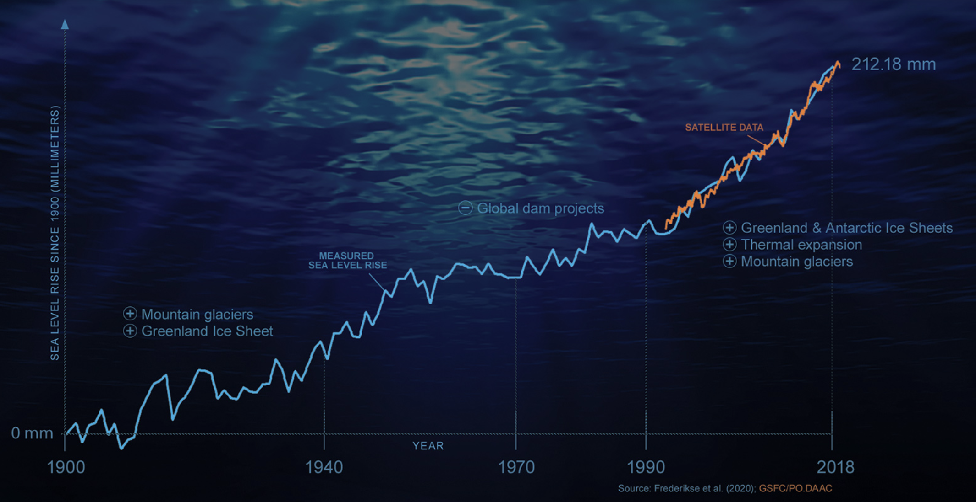
Thermodynamics and global sea level rise
https://climate.nasa.gov/news/3012/nasa-led-study-reveals-the-causes-of-sea-level-rise-since-1900/
What does thermodynamics have to say about this?

Slide 3
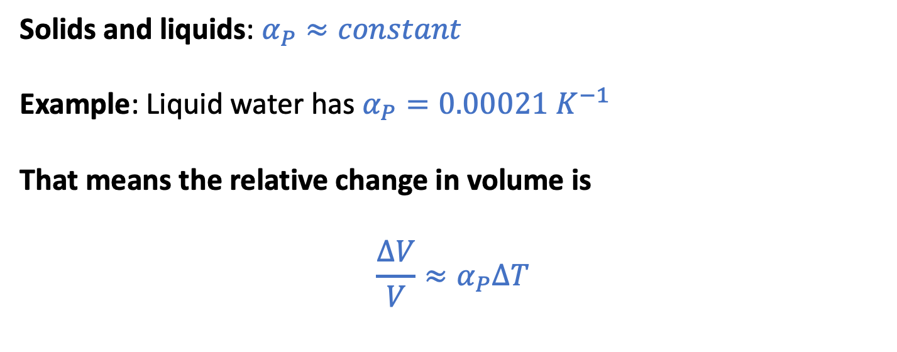


The isobaric thermal expansivity (focusing on the oceans)
$$α_{P}≡\frac{1}{V}{\left(\frac{∂V}{∂T}\right)}_{P}$$
$$∆V$$
Solids and liquids: $α_{P}≈constant$
Example: Liquid water has $α_{P}=0.00021{ K}^{−1}$
That means the relative change in volume is
$${\frac{∆V}{V}≈α}_{P}∆T$$
$$V$$

Slide 4



The isobaric thermal expansivity (focusing on the oceans)
$$α_{P}≡\frac{1}{V}{\left(\frac{∂V}{∂T}\right)}_{P}$$
For a given column of water, this means
$${\frac{∆h}{h}≈α}_{P}∆T$$
or
$$∆h {≈h α}_{P}∆T$$
$$∆h$$
$$h$$

Slide 5
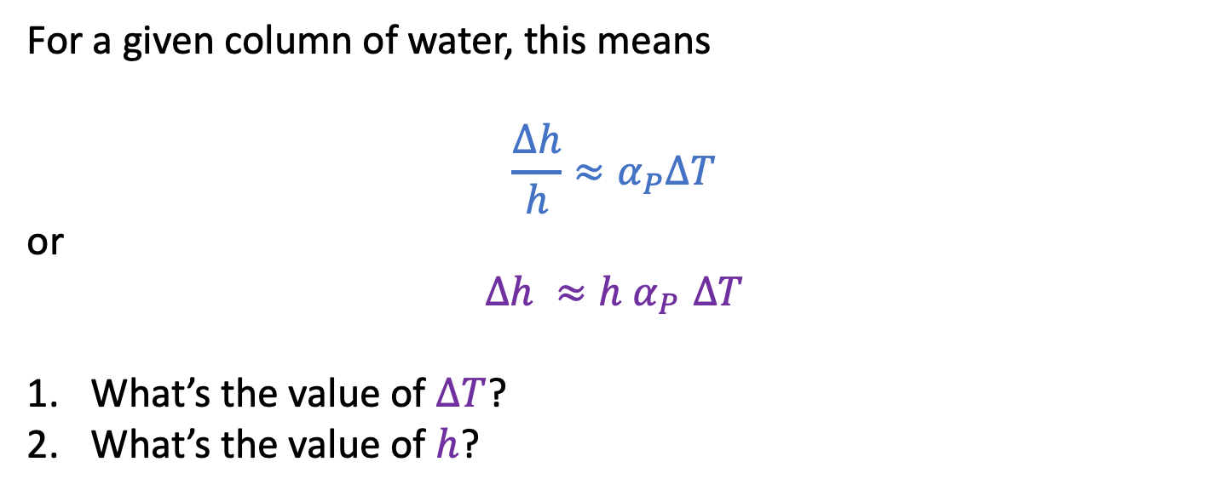
The isobaric thermal expansivity (focusing on the oceans)
$$α_{P}≡\frac{1}{V}{\left(\frac{∂V}{∂T}\right)}_{P}$$
For a given column of water, this means
$${\frac{∆h}{h}≈α}_{P}∆T$$
or
$$∆h {≈h α}_{P}∆T$$
What’s the value of $∆T$?
What’s the value of $h$?
$$∆h$$
$$h$$

Slide 6
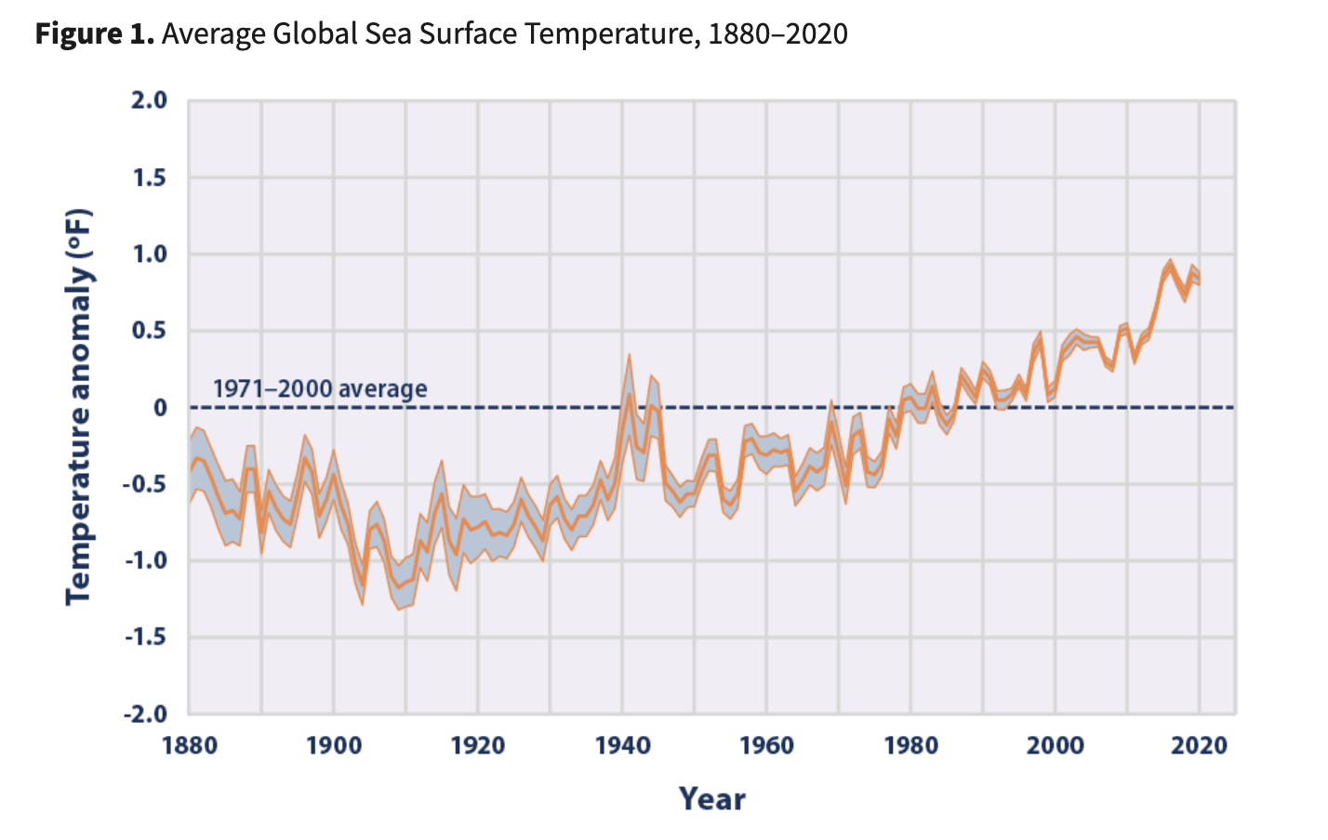


Global sea surface temperature, 1880-2020
$$∆T= 1.5 ℉= 0.8 K$$
Looks like $∆T$ for the ocean surface is $\sim 0.8 K$
https://www.epa.gov/climate-indicators/climate-change-indicators-sea-surface-temperature

Slide 7
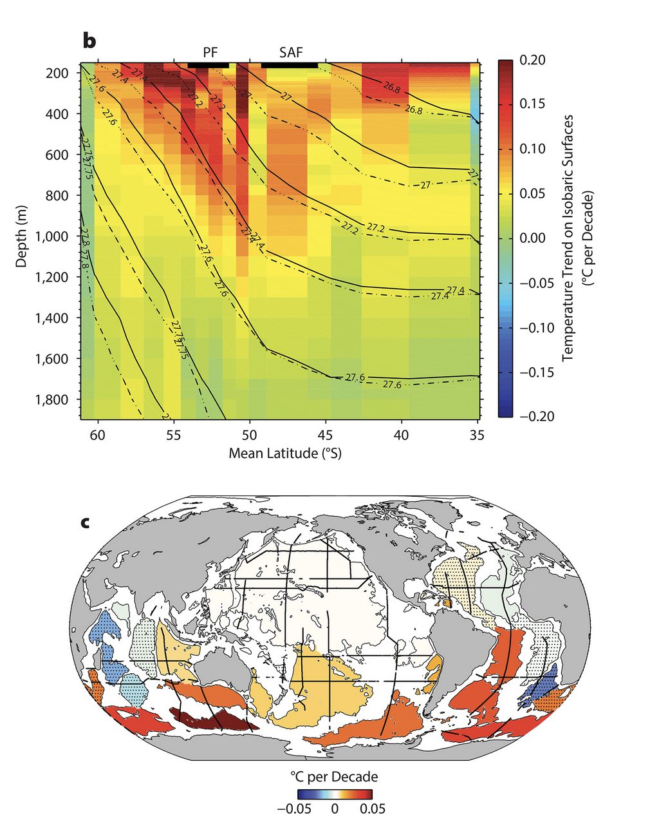
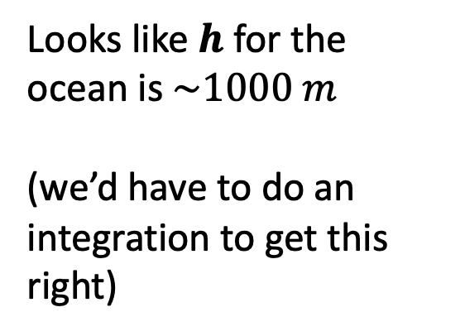
Depth of the warming (Southern Ocean)
Looks like $h$ for the ocean is $\sim 1000 m$
(we’d have to do an integration to get this right)
https://tos.org/oceanography/article/southern-ocean-warming

Slide 8
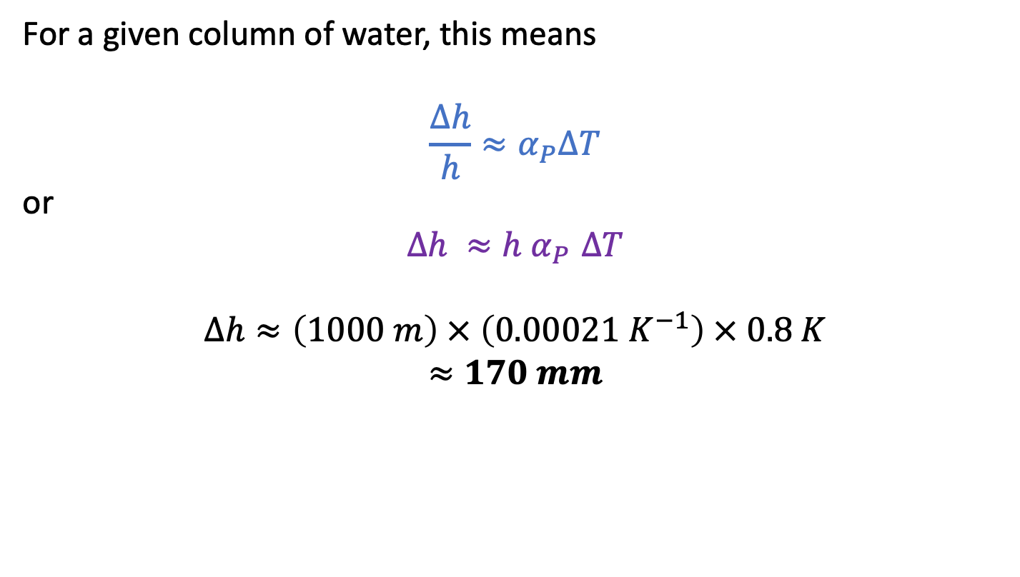
Predicting sea level rise due to thermal expansion
$$α_{P}≡\frac{1}{V}{\left(\frac{∂V}{∂T}\right)}_{P}$$
For a given column of water, this means
$${\frac{∆h}{h}≈α}_{P}∆T$$
or
$$∆h {≈h α}_{P}∆T$$
$$∆h≈\left(1000 m\right) × \left(0.00021{ K}^{−1}\right) × 0.8 K$$
$$≈170 mm$$
$$∆h$$
$$h$$

Slide 9
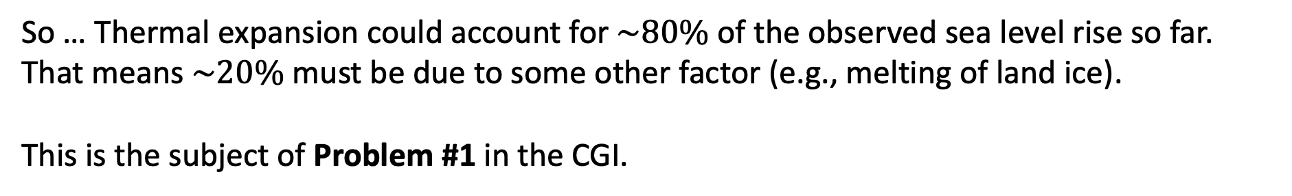
But the observed sea level rise (in 2018) was more like 212 mm
So … Thermal expansion could account for $\sim 80\%$ of the observed sea level rise so far. That means $\sim 20\%$ must be due to some other factor (e.g., melting of land ice).
This is the subject of Problem #1 in the CGI.

Slide 10
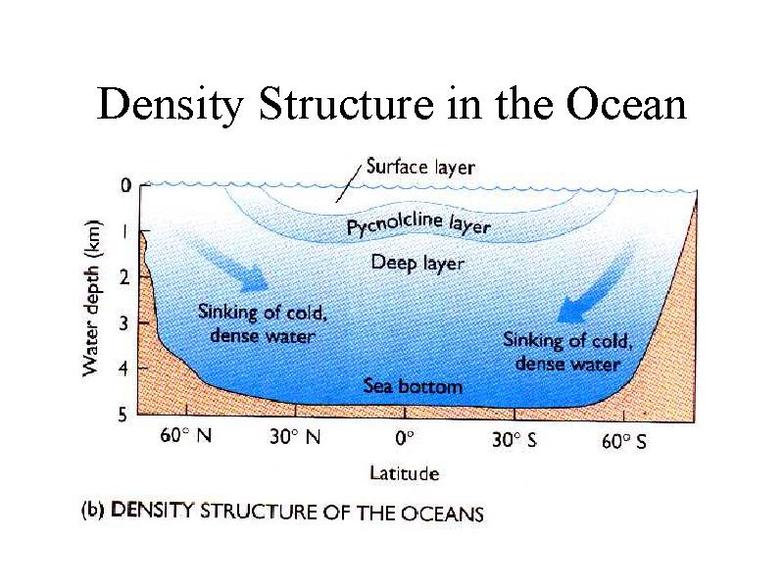
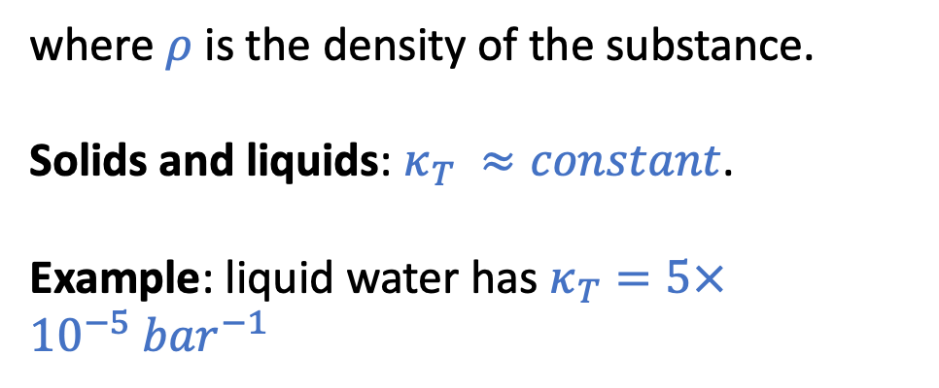
Next: the isothermal compressibility (of water)
$κ_{T}≡−\frac{1}{V}{\left(\frac{∂V}{∂P}\right)}_{T}$ … for small changes in pressure, we can say $\frac{∆V}{V}=\frac{∆ρ}{ρ}≈{−κ}_{T}∆P$
where $ρ$ is the density of the substance.
Solids and liquids: $κ_{T} ≈constant$.
Example: liquid water has $κ_{T}=5×10^{−5}{ bar}^{−1}$
http://www.ccpo.odu.edu/~atkinson/OCN306/lec42/img019.jpg

Slide 11
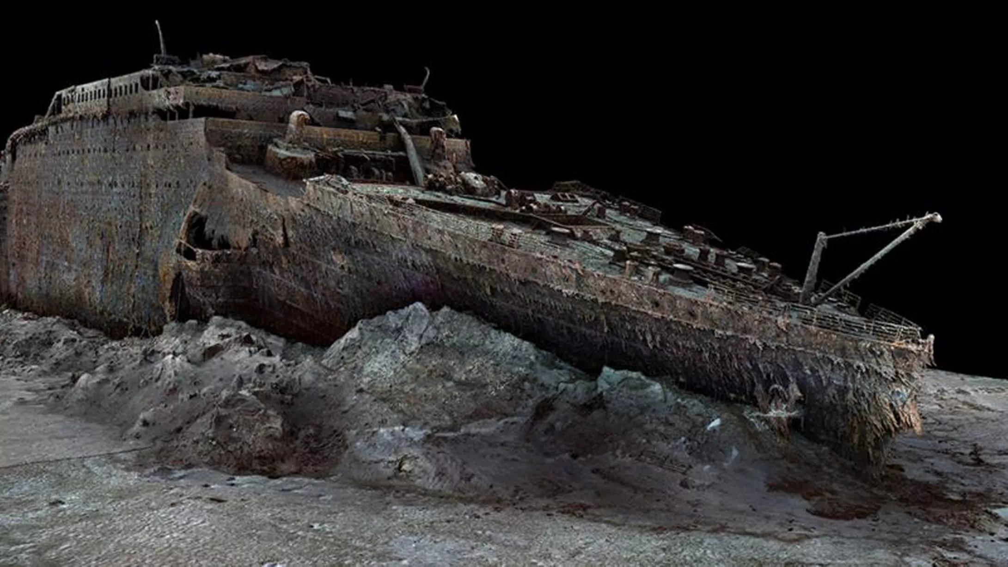
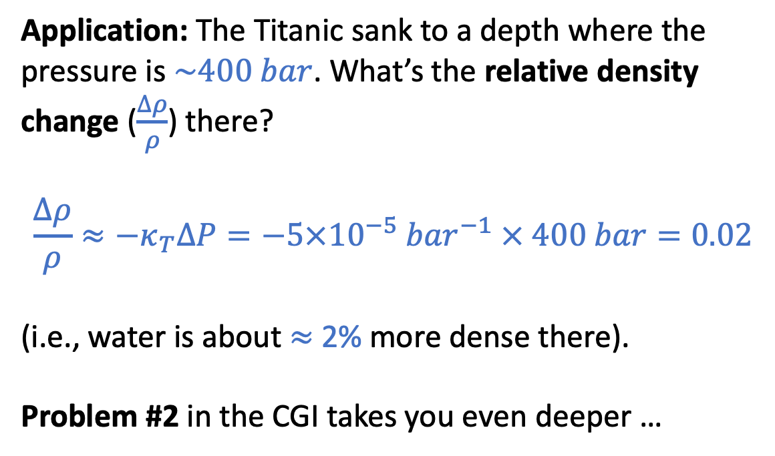
Next: the isothermal compressibility (of water)
$κ_{T}≡−\frac{1}{V}{\left(\frac{∂V}{∂P}\right)}_{T}$ … for small changes in pressure, we can say $\frac{∆V}{V}=\frac{∆ρ}{ρ}≈{−κ}_{T}∆P$
Application: The Titanic sank to a depth where the pressure is $\sim 400 bar$. What’s the relative density change ($\frac{∆ρ}{ρ}$) there?
$$\frac{∆ρ}{ρ}≈{−κ}_{T}∆P=−5×10^{−5}{ bar}^{−1} × 400 bar=0.02$$
(i.e., water is about $≈$ 2% more dense there).
Problem #2 in the CGI takes you even deeper …
2.4 miles (13,000 feet)

Slide 12
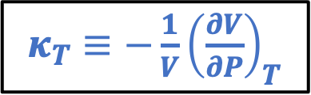
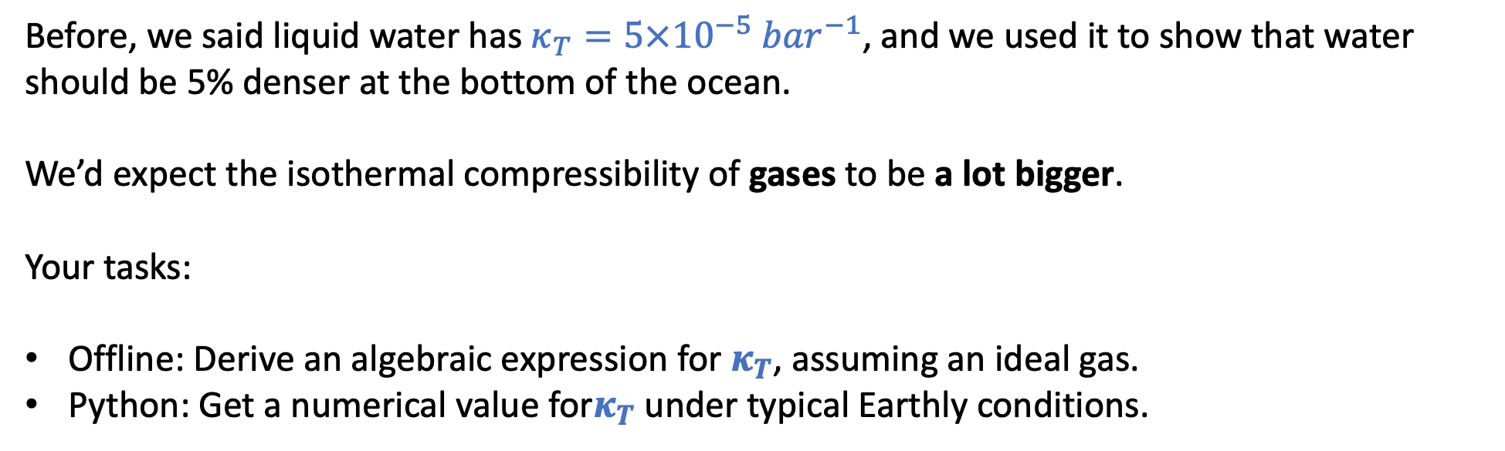
Next: the isothermal compressibility of an ideal gas
$κ_{T}≡−\frac{1}{V}{\left(\frac{∂V}{∂P}\right)}_{T}$
Before, we said liquid water has $κ_{T}=5×10^{−5}{ bar}^{−1}$, and we used it to show that water should be 5% denser at the bottom of the ocean.
We’d expect the isothermal compressibility of gases to be a lot bigger.
Your tasks:
Offline: Derive an algebraic expression for $κ_{T}$, assuming an ideal gas.
Python: Get a numerical value for$κ_{T}$ under typical Earthly conditions.

Slide 13
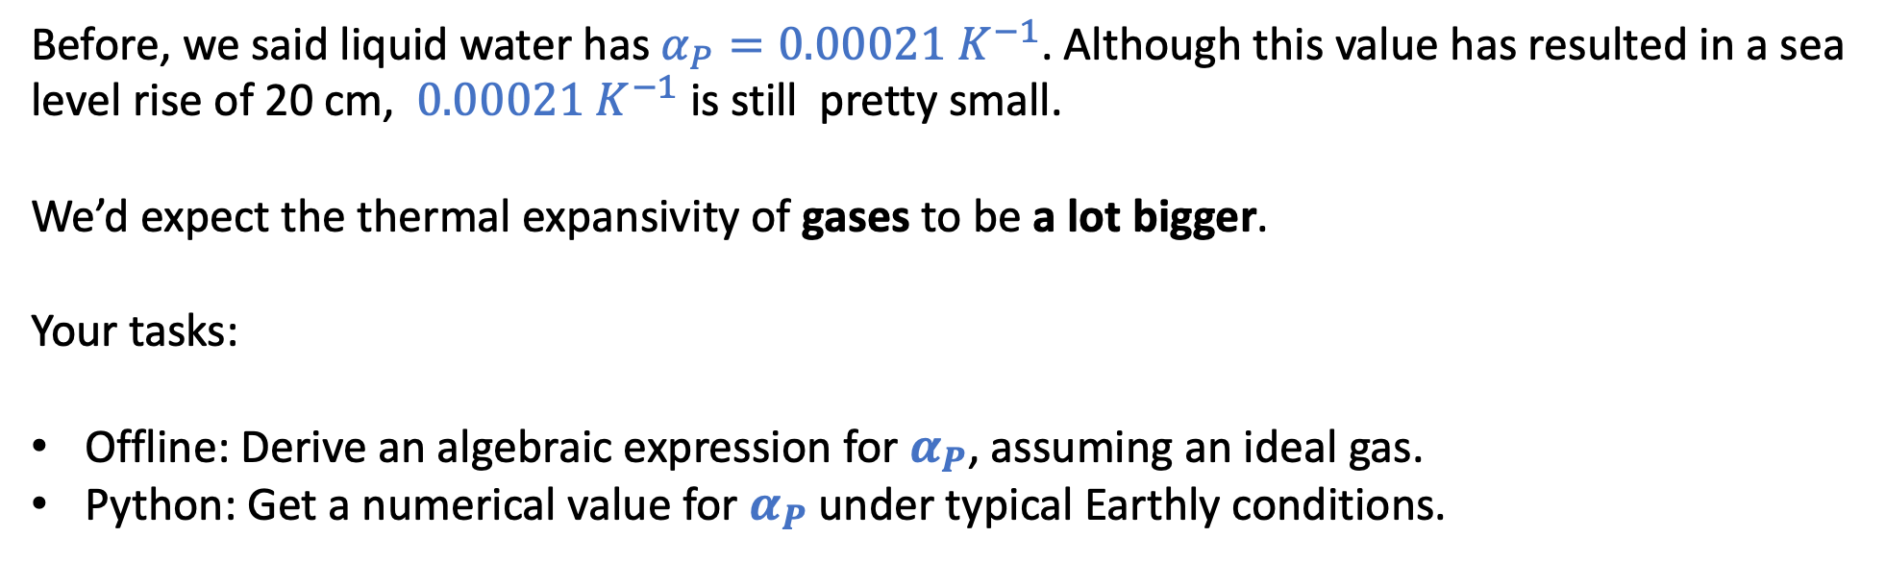
Next: the isobaric thermal expansivity of an ideal gas
$α_{P}≡\frac{1}{V}{\left(\frac{∂V}{∂T}\right)}_{P}$ … for small changes in temperature, we can say $\frac{∆V}{V}≈α_{P}∆T$
Before, we said liquid water has $α_{P}=0.00021{ K}^{−1}$. Although this value has resulted in a sea level rise of 20 cm, $0.00021{ K}^{−1}$ is still pretty small.
We’d expect the thermal expansivity of gases to be a lot bigger.
Your tasks:
Offline: Derive an algebraic expression for $α_{P}$, assuming an ideal gas.
Python: Get a numerical value for $α_{P}$ under typical Earthly conditions.

Slide 14
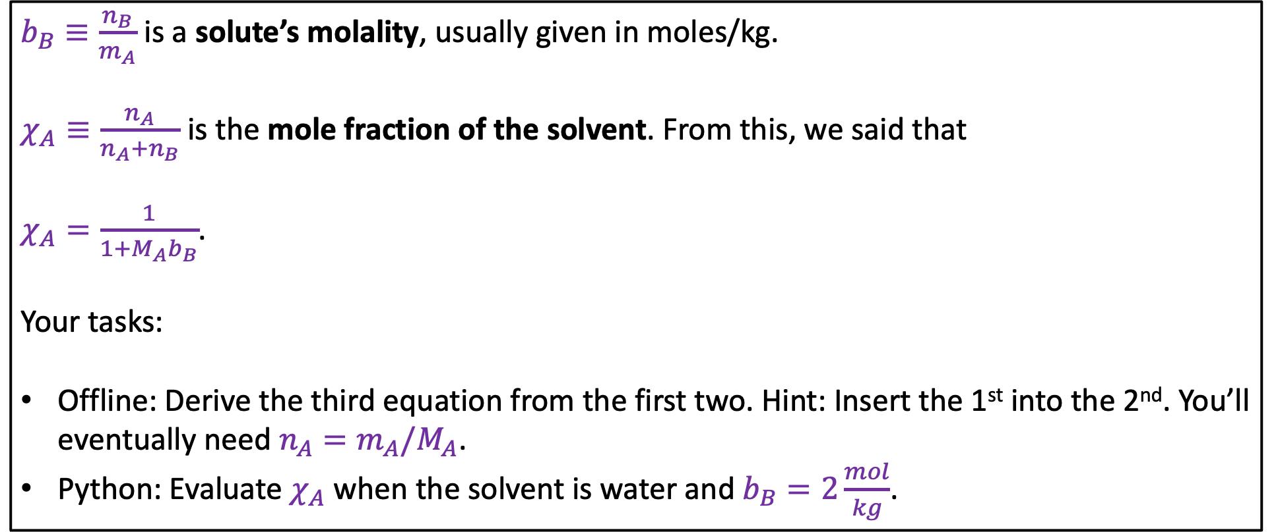
Next: the relationship between molality and mole fraction
$b_{B}≡\frac{n_{B}}{m_{A}}$ is a solute’s molality, usually given in moles/kg.
$χ_{A}≡\frac{n_{A}}{n_{A}+n_{B}}$ is the mole fraction of the solvent. From this, we said that
$χ_{A}=\frac{1}{1+M_{A}b_{B}}$.
Your tasks:
Offline: Derive the third equation from the first two. Hint: Insert the 1st into the 2nd. You’ll eventually need $n_{A}=m_{A}/M_{A}$.
Python: Evaluate $χ_{A}$ when the solvent is water and $b_{B}=2\frac{mol}{kg}$.

Slide 15
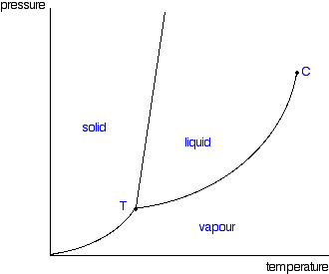

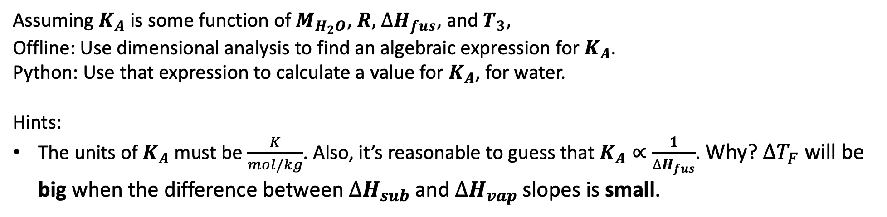

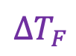
Next: deriving $K_{A}$ of Blagdon’s Law by dimensional analysis
P
Blagden says $∆T_{F}=K_{A}b_{B} i_{B}$
$∆T_{F}$
T
$$b_{B}$$
Assuming $K_{A}$ is some function of $M_{H_{2}O}$, $R$, $∆H_{fus}$, and $T_{3}$,
Offline: Use dimensional analysis to find an algebraic expression for $K_{A}$.
Python: Use that expression to calculate a value for $K_{A}$, for water.
Hints:
The units of $K_{A}$must be $\frac{K}{mol/kg}$. Also, it’s reasonable to guess that $K_{A}∝\frac{1}{∆H_{fus}}$. Why? $∆T_{F}$ will be big when the difference between $∆H_{sub}$ and $∆H_{vap}$ slopes is small.

Slide 16
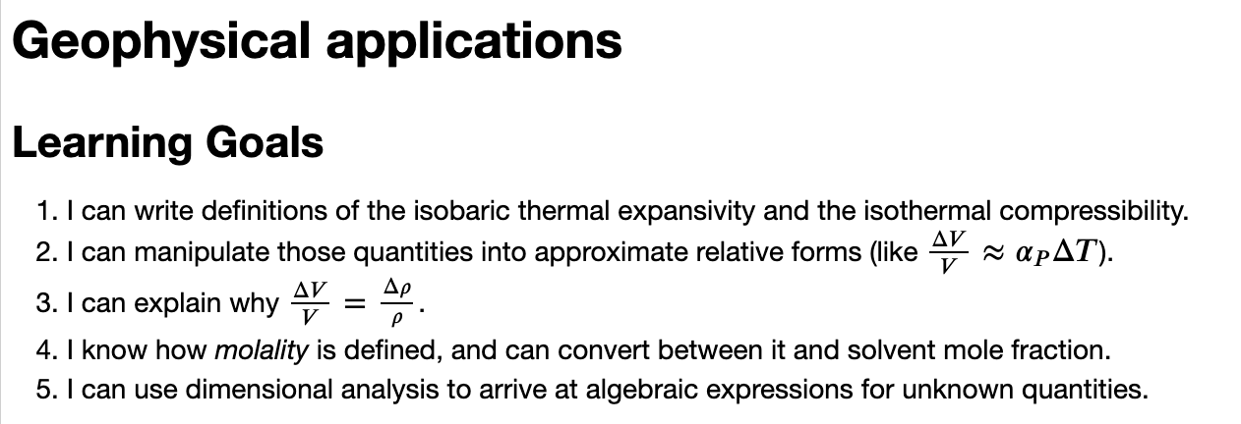
OK, let’s get started

